Slide 1
Section 4(f) and 6(f)
ENVE F644: Environmental Management and Permitting
MaLinda Malenfant
April 2020

Slide 2
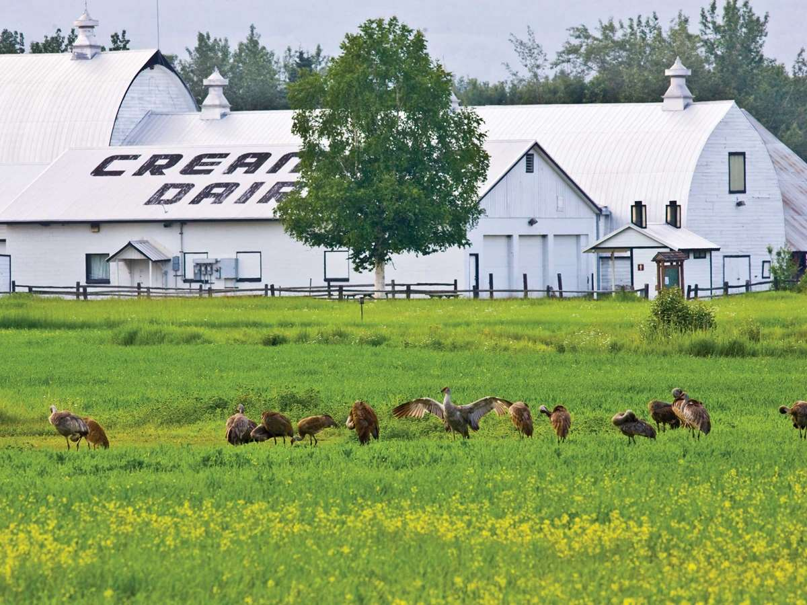
Section 4(f) of U.S. DOT Act Introduction:
Regulation: 23 CFR Part 774
“Parks, Recreational Areas, Wildlife and Waterfowl Refuges, and Historical Sites”
Codified at 23 U.S.C. 138 and 49 U.S.C. 303
The Federal Highway Administration and other Department of Transportation entities cannot approve the use of publically used land for federal highway projects, such as:
Publicly owned parks
Recreational areas
Wildlife and waterfowl refuges
Public or private historical sites

Slide 3
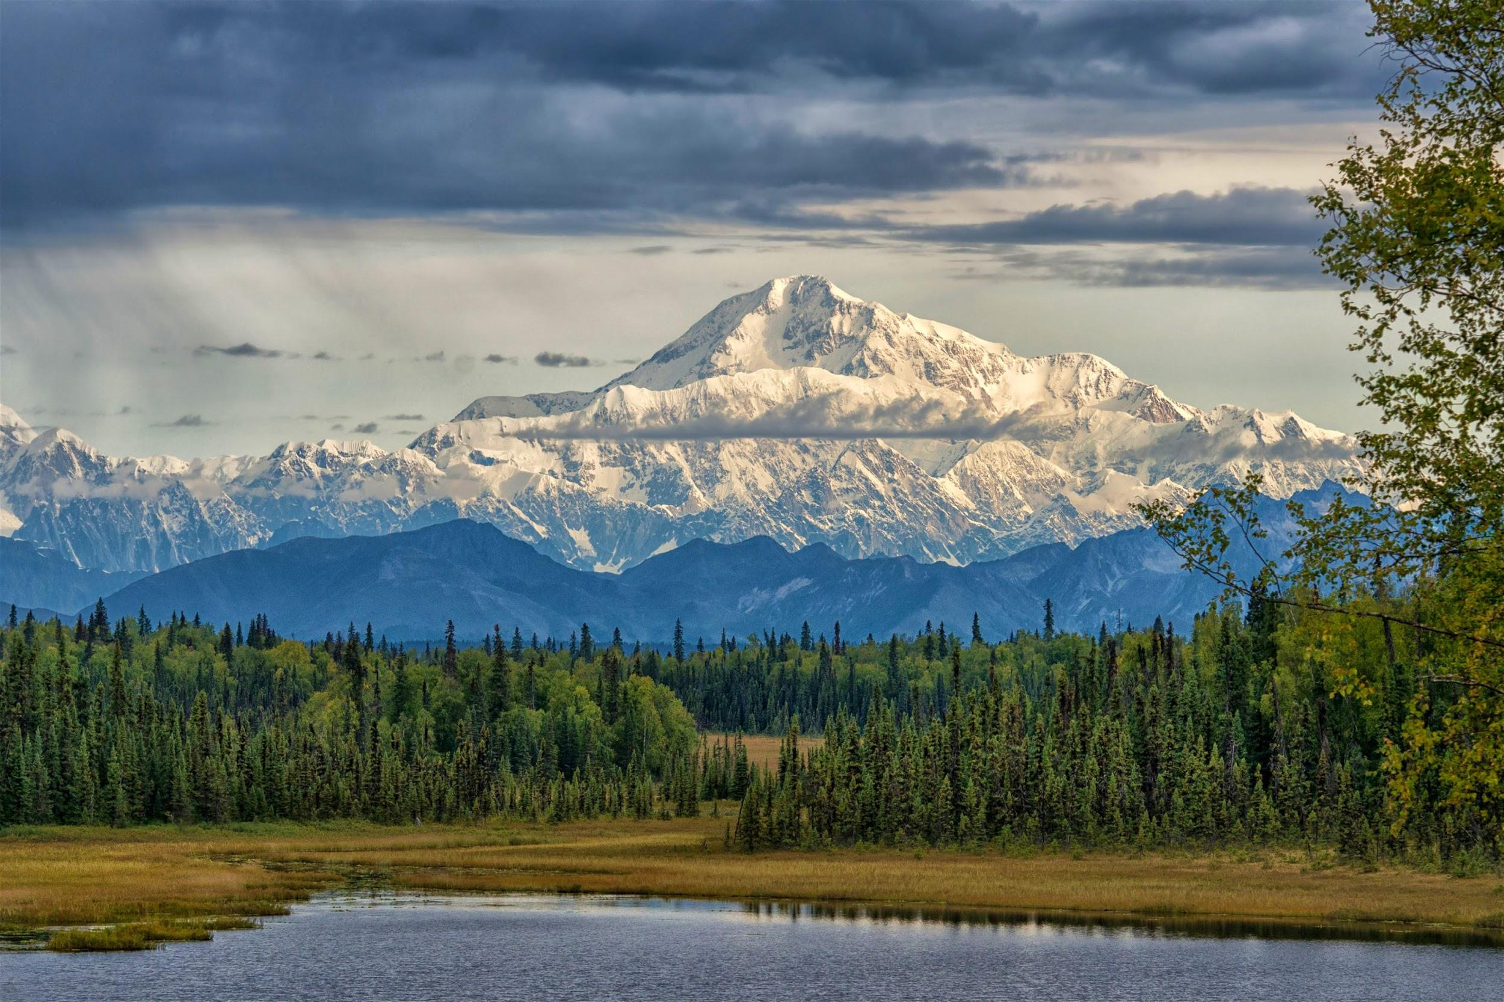
Exceptions to Section 4(f) of U.S. DOT Act
There is found to be “ no feasible and prudent avoidance alternative to the use of land” and includes planning to minimize harm to the property
OR
It is determined that the use of the property will have a “de minimis” impact
de minimis: about minimal things
When pertaining to this law: too minor to merit consideration

Slide 4
Authority to regulate:
The Secretary of the US DOT is the ultimate decision maker for Section 4(f)
-- They are encouraged to consult Secretaries of the Interior, Housing and
Urban Development, and Agriculture
Examples:
Historical Sites: State Historical Preservation Officer (SHPO)
Tribal lands: Tribal Historical Preservation Officer (THPO)
National historical landmark: official from National Park Service

Slide 5
Exceptions when required to consult
Officials have been consulted and “have not objected” for
Applying exception for restoration/rehabilitation/or maintenance of historical transportation facilities
23 CFR 774.13 (a)
Applying exception for archeological sites of minimal value for preservation in place 23 CFR 774.13 (b)
Officials have given “written concurrence” for
No adverse effects prior to de minimis findings 23 CFR 774.5 (b)
Applying exceptions for temporary occupancies 23 CFR 774.13 (d)
Applying exceptions for transportation enhancement activities and mitigation activities 23 CFR 774.13 (g)

Slide 6

When does Section 4(f) apply?
When US DOT approves a transportation program or project that uses property outlined in Section 4(f)
* currently FHWA doesn’t approve transportation programs, so only projects apply *
In addition, the following four conditions must be met:
Project must require approval from FHWA to proceed
Must be considered a transportation project
Must require use of the land from a protected property by Section 4(f)
None of the regulatory applicability rules or exceptions apply

Slide 7
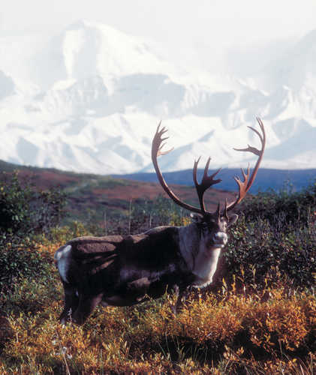
Where doesn’t Section 4(f) apply?
Additional info about where Section 4(f) isn’t applicable can be found in Part II of the Section 4(f) Policy Paper
https://www.environment.fhwa.dot.gov/legislation/section4f/4fpolicy.aspx#intro
In these situations, the FHWA requires sufficient documentation to demonstrate why the determination is made that Section 4(f) is not applicable

Slide 8
Programmatic Evaluations:
Five National Programmatic Evaluations that can be used in place of Individual Evaluations if the situation applies.
These do not require draft, comment, or circulation periods because they have already been approved by DOI.
Independent Bikeway or Walkway Construction Projects (approved May 23, 1977)
Use of Historic Bridges (approved July 5, 1983)
Minor Involvement with Public Parks, Recreation Lands, and Wildlife and Waterfowl Refuges (approved December 23, 1986)
Minor Involvement with Historic Sites (approved December 23, 1986)
Transportation Projects that have a Net Benefit to Section 4(f) Property (approved April 20, 2005)

Slide 9
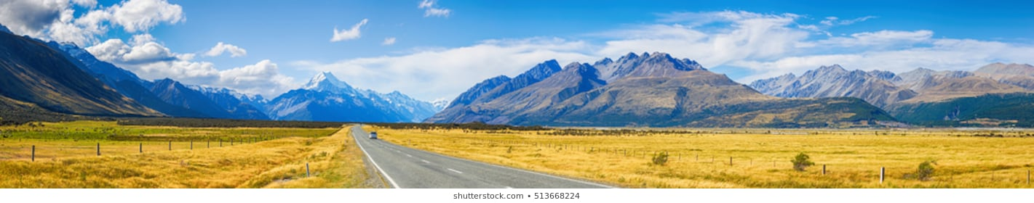
Individual Evaluations:
Requires two drafts: draft and final
These need to be submitted to the FHWA Division Office or the Federal Lands Division Office.
Final evaluations need to be sent to the FHWA’s Office of Chief Counsel for legal sufficiency review.
The project sponsor should submit drafts that
Identify and evaluate avoidance alternatives
Identify and evaluate ways to decrease harm to the section 4(f) property

Slide 10
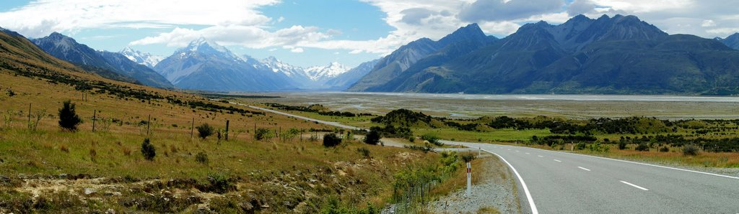
In these cases:
EIS/EA: the evaluation should be submitted as a NEPA subsection
CE and in projects where plan changes have been made after processing CE or FONSI : the evaluation should be a separate document
Individual Evaluations Cont.

Slide 11
Section 6(f) Introduction:
Of the Land and Water Conservation Fund Act
LWCFA of 1965 was enacted to establish a funding source for State and Federal agencies to meet present and future recreational demands.
Funds can be used for:
Planning
Acquisition
Development
Section 6(f) specifies that all lands utilizing funds from the LWCFA need to be maintained as such, and cannot be converted into anything other than a recreational area without approvals

Slide 12
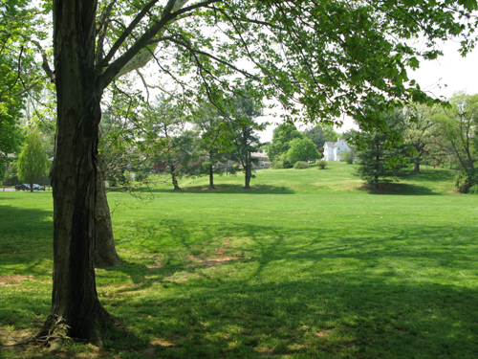
Who can approve?
LWCF Act is administered by the Department of the Interior (DOI) and the National Park Service (NPS)
Lands which utilize LWCF Act cannot be converted unless approved by the Secretary of DOI through the NPS at the State’s request.

Slide 13
Use of LWCF Act Lands:
Section 6(f) directs DOI to ensure replacement lands for LWCFA lands that are used for projects.
Replacement lands need to be equal in:
Fair market value
Location
Usefullness
*Also need to meet eligibility requirements as outlined in 36 CFR 59.3(b)(4)(i-iv)*

Slide 14
Section 4(f) and 6(f) overlap
Section 6(f) lands, because they are used for recreation, often overlap with Section 4(f) of the U.S. DOT Act.
When identifying lands encompassed by Section 4(f) for projects, it may be also necessary to determine if any of the lands proposed also fall under Section 6(f) of the LWCFA.
If they do, mitigation effects should take into consideration not only the Section 4(f) requirements, but also Section 6(f) requirements.

Slide 15
Thank you
Questions?

Slide 16
Photo’s used:
https://www.travelalaska.com/Destinations/Parks-and-Public-Lands/Creamers-Field-Migratory-Waterfowl-Refuge.aspx
https://www.lonelyplanet.com/usa/alaska/denali-national-park
https://alaskaphotographics.photoshelter.com/img-show/I0000l24IEItjQ0s
https://www.fhwa.dot.gov/byways/photos/77722
https://www.shutterstock.com/search/car+road+panorama
https://mapio.net/pic/p-27659723/

Slide 17
Works cited
“Section 4(f).” FHWA, www.environment.fhwa.dot.gov/legislation/section4f.aspx.
“SECTION 4(f) POLICY PAPER.” FHWA, www.environment.fhwa.dot.gov/legislation/section4f/4fpolicy.aspx#doc.
“Section 4(f).” Environmental Review Toolkit, www.environment.fhwa.dot.gov/legislation/section4f/4f_minor_parks.aspx.
Fhwa. “Evaluations.” Section 4(f) Evaluations, www.environment.fhwa.dot.gov/env_topics/4f_tutorial/evaluations_individ.aspx.
“Section 4(f)/Section 6(f).” Center for Environmental Excellence by AASHTO, environment.transportation.org/environmental_topics/section_4f/overview.aspx.

